Slide 1
Developing a Consumer App
Bharath Prasad

Slide 2
Topics Covered
What is a consumer App ?
Characteristics
Factors influencing Design
Examples
Key Considerations
Storage
Network
Compute
Security
Non-Functional Requirements
Support

Slide 3
What is a consumer App ?
Apps designed to accommodate consumer needs and wants
Social Media apps, games, communication platforms, photo and video editing apps etc.
The primary goal of a consumer apps is to generate revenue or connect consumers to businesses
The consumer app should be intuitive, simple, easy to use and should be faster.
Consumer apps are designed to target any person who comes in contact with the app, no matter which part of the world or which organization they belong to

Slide 4
Factors influencing Design
Some Key factors to consider:
Geographical Region
Age Group
Gender
Income segment
Is the app used by PWD ?
Languages Spoken
Type of the app ?
Business Goals
Internet Speeds
Place and Time where the app is used
Mobile Phones / Platforms used
Concurrency / Parallel instances
Processing of Personal Data
Payments involved ?
Escrow Accounts involved ?
Country related legal requirements
…

Slide 5
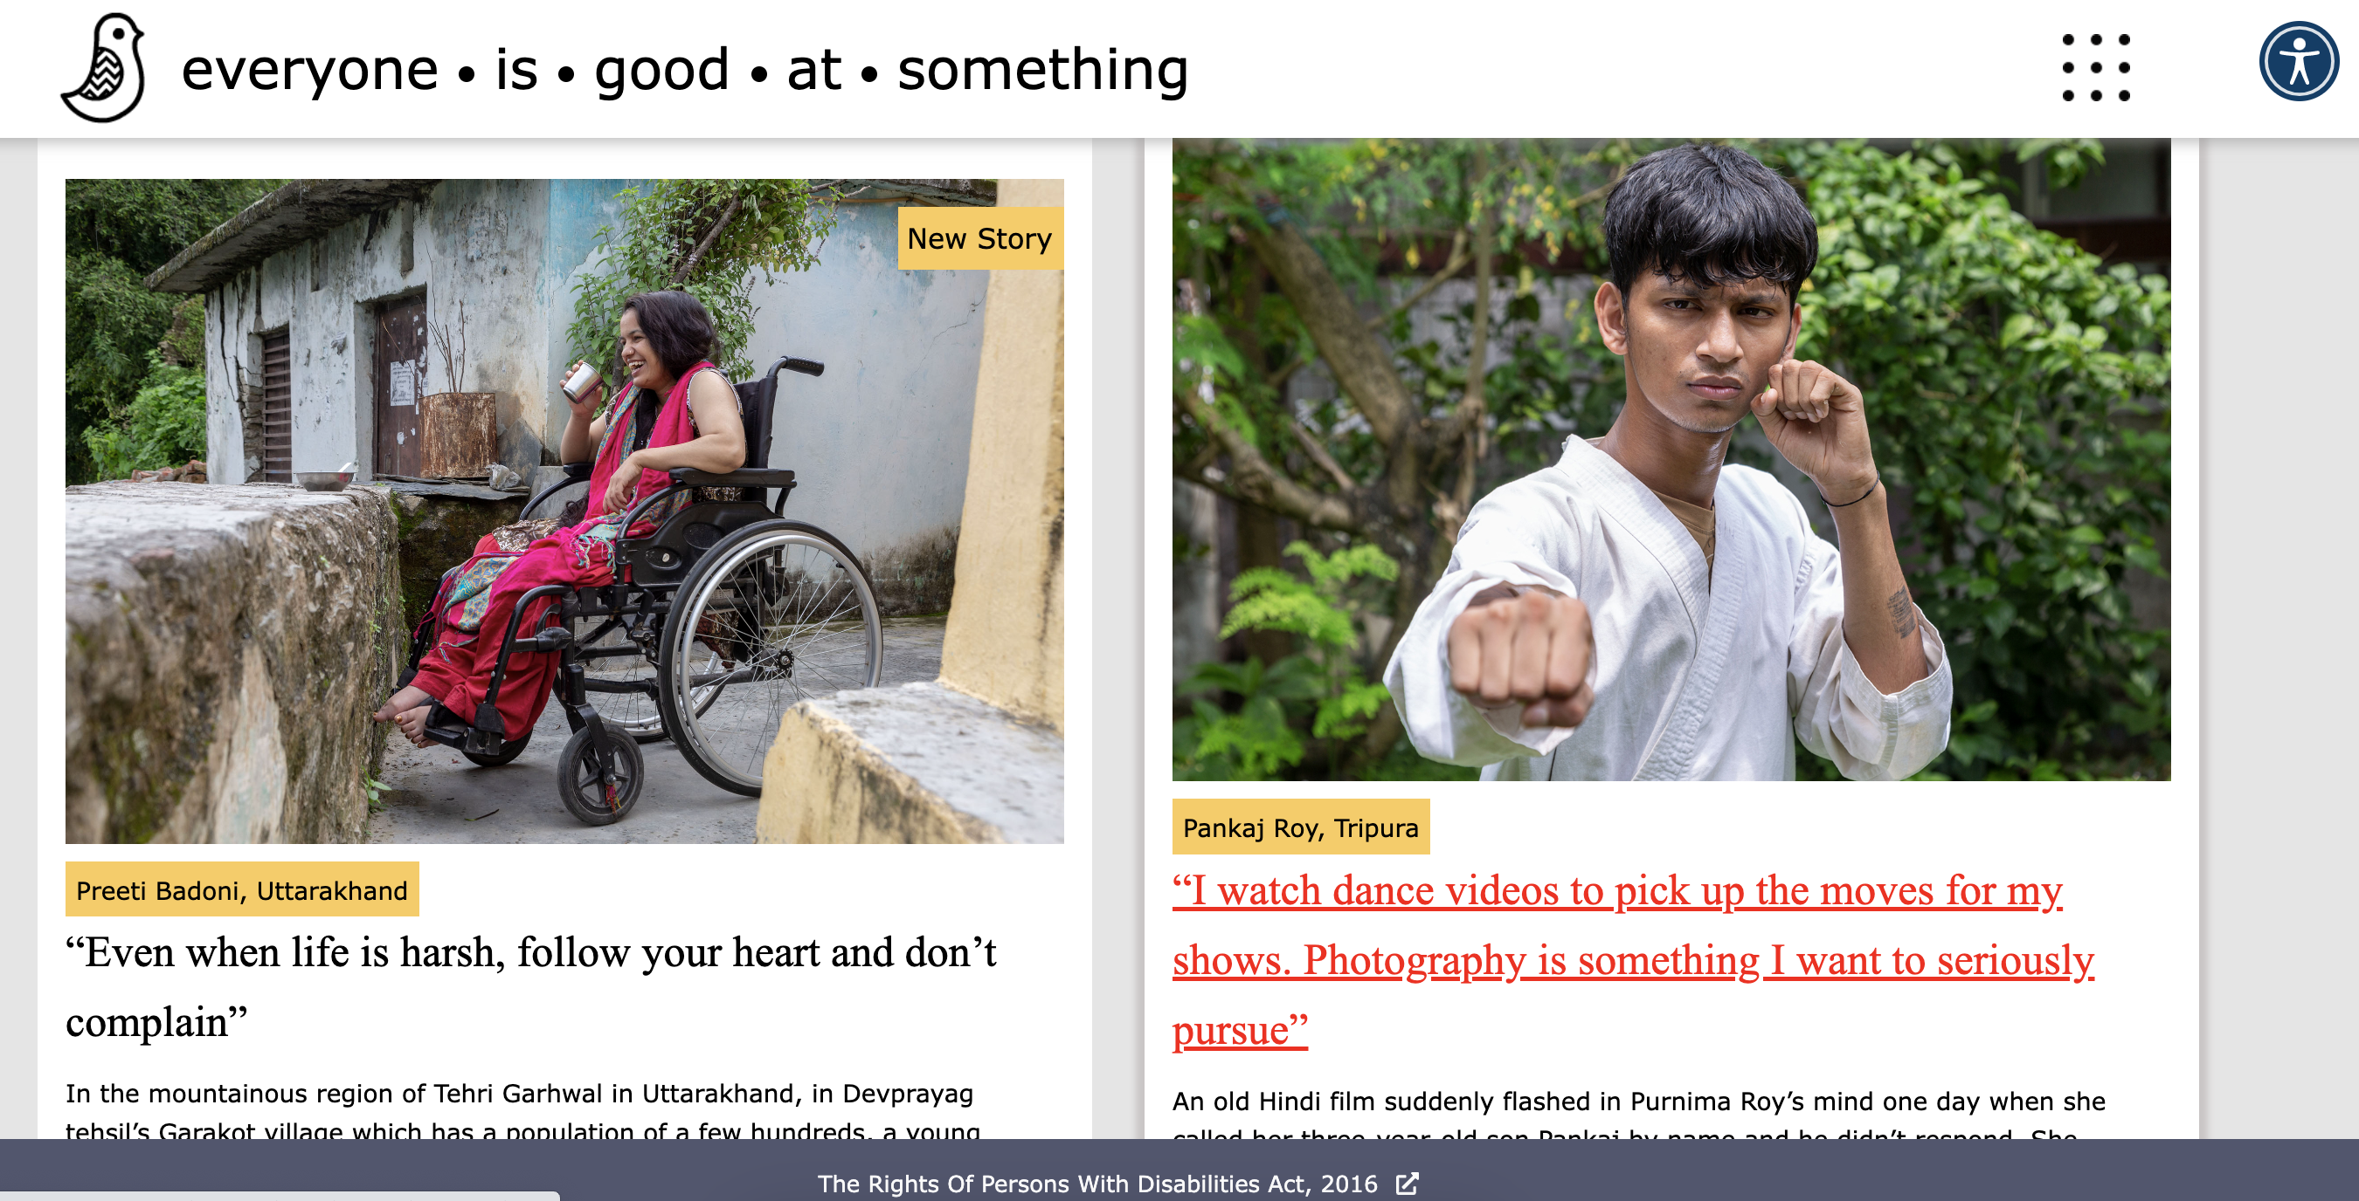
Everyoneisgoodatsomething.com (EGS)
Website covers inspiring lives of People
with disabilities
Published in 6 Languages
Weekly publishing cycle
Users across 13 Countries
Disability friendly

Slide 6
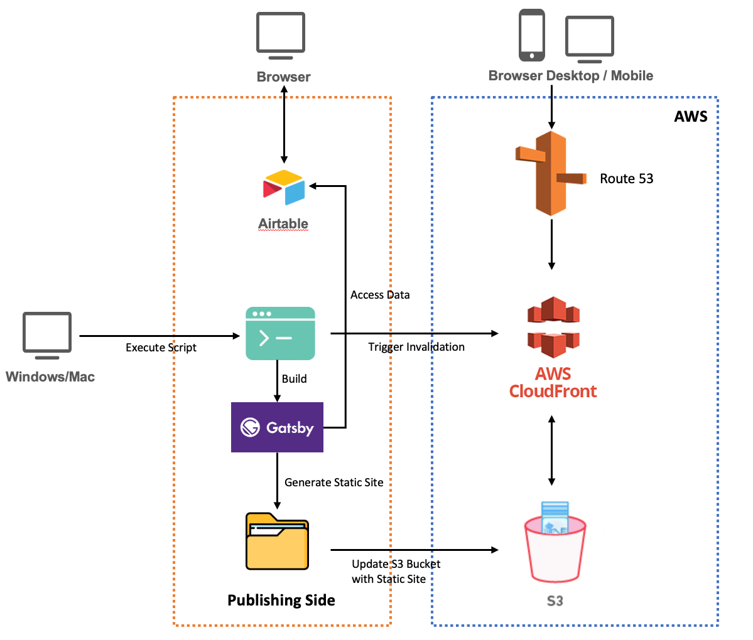
EGS Key Considerations
Frontend : HTML, CSS & JS using site generator such as Gatsby
Backend : Airtable
Hosting : via AWS S3
CDN : AWS Cloudfront
Deployment : Shell Script, can also be automated via github actions
Monthly AWS Cost: $0.7/month

Slide 7
EGS – How Tos
Frontend :Gatsby https://www.youtube.com/playlist?list=PL4cUxeGkcC9hw1g77I35ZivVLe8k2nvjB
Backend : Airtable
https://www.airtable.com/guides/start/airtable-basics
Hosting : via AWS S3
https://docs.aws.amazon.com/AmazonS3/latest/userguide/WebsiteHosting.html
CDN : AWS Cloudfront
https://docs.amazonaws.cn/en_us/AmazonCloudFront/latest/DeveloperGuide/GettingStarted.SimpleDistribution.html

Slide 8
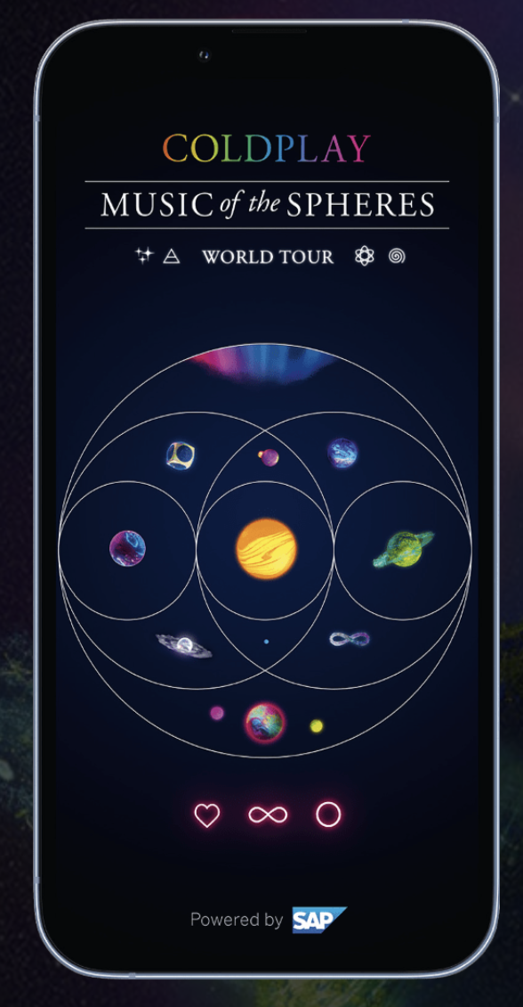
Coldplay
Developed for fans of Coldplay Band
Coldplay is currently on their world tour for their album “Music of the Spheres”
Features such as Tour Schedule, Carbon impact calculator, Mini games, NEWS, AR, Featured Videos are supported
Native Android and iOS App
English only
Weekly release cycle
Users across 73 Countries

Slide 9
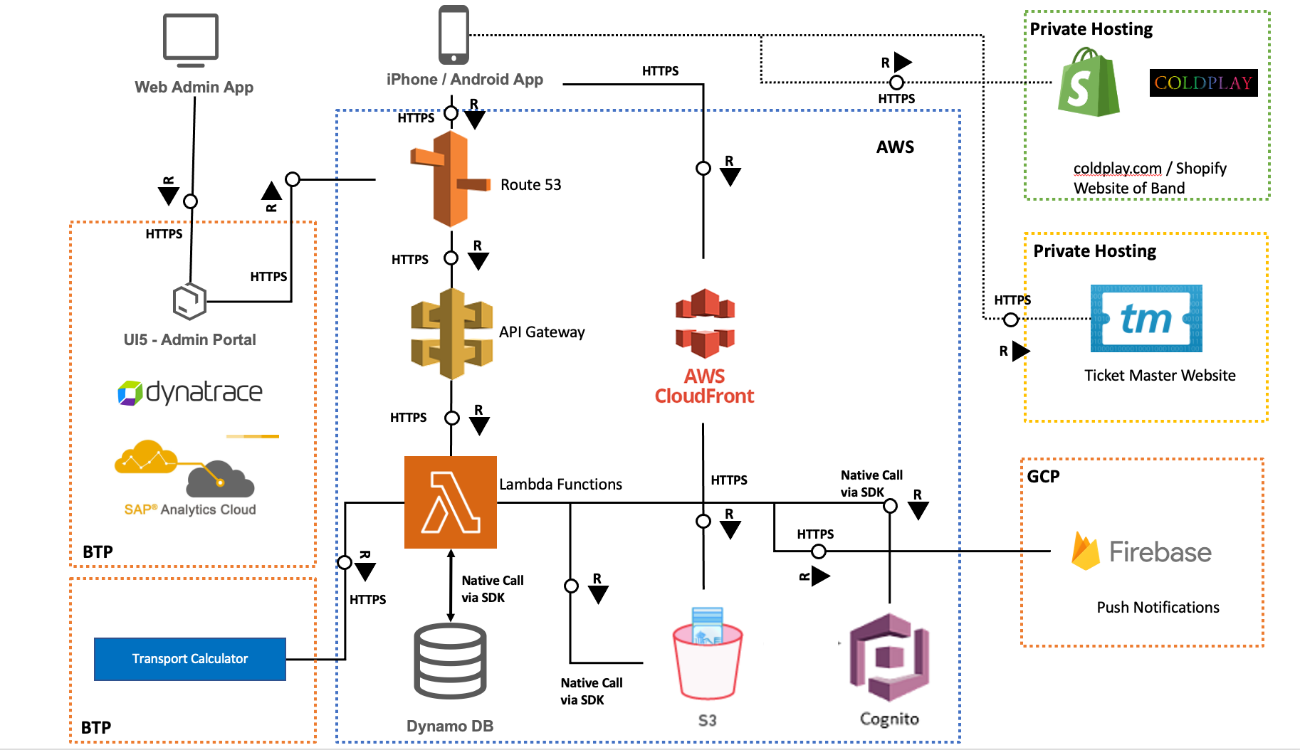
Coldplay App Key Considerations
Storage / Data :
App is read heavy
Content are of 2 types: Static and Dynamic
Convert some dynamic content that don’t change often to static
Try to optimize the data format not just data (explore avro, messagepack, protobuf etc)
App should work offline, cache/store data efficiently on mobile
App makes read request only when there are changes
Replicate data using Global Table replication

Slide 10
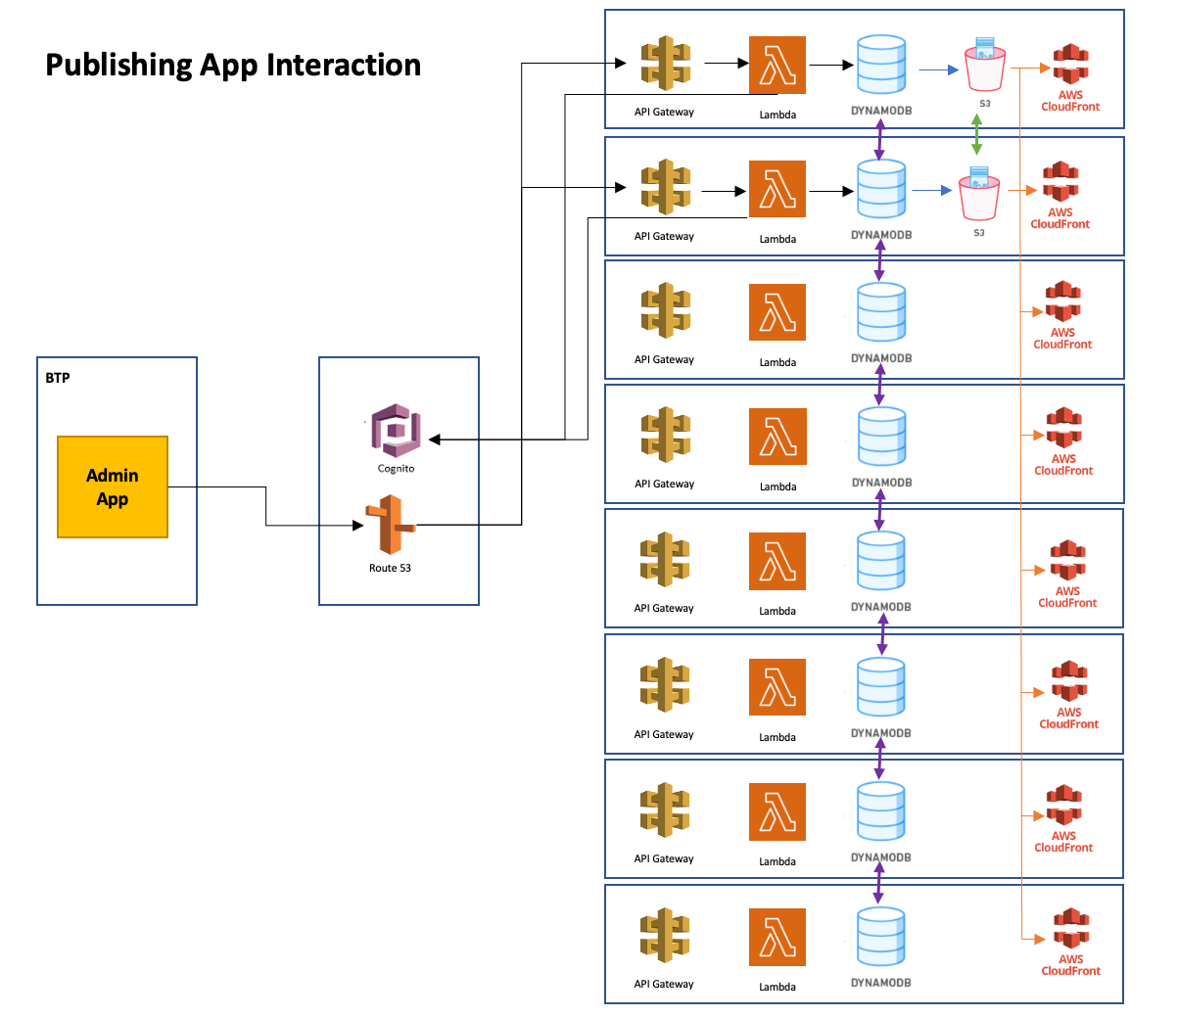
Coldplay App Key Considerations
Network:
Follow the tour concept
Backend components are deployed in 8 regions currently
Replication of data is taken care by Global Table replication of DynamoDB
Replication of S3 Bucket content is taken care by S3 replication
Static Content is served via AWS CloudFront
Nearly a billion calls to static content is made and served

Slide 11
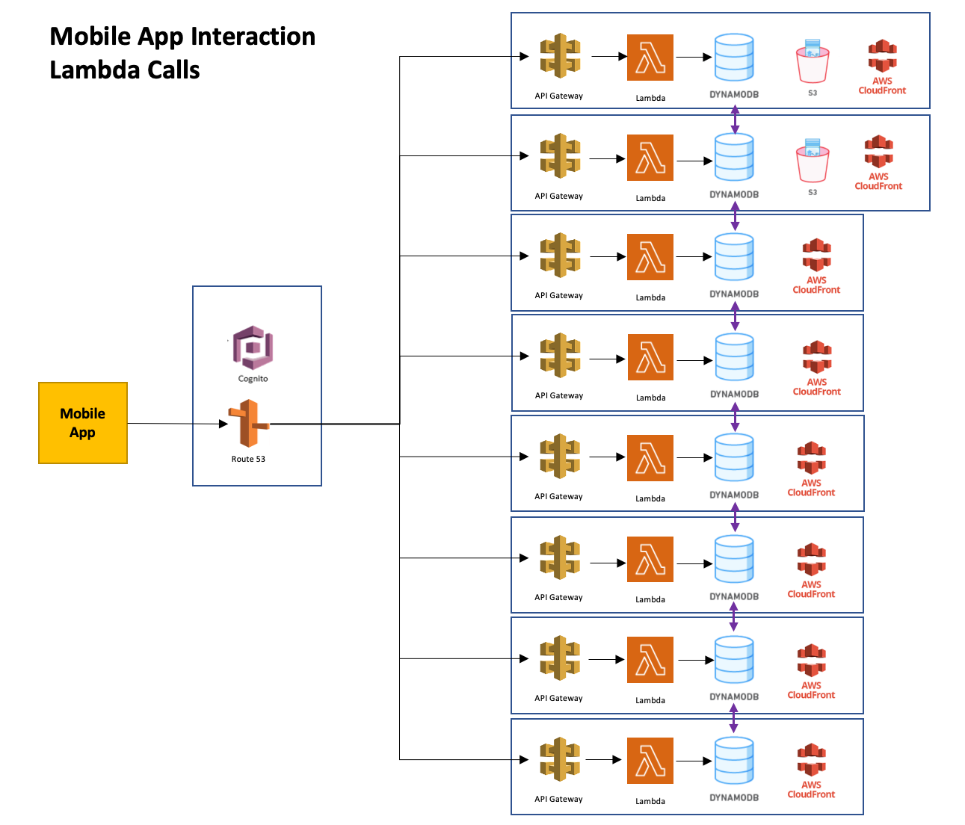
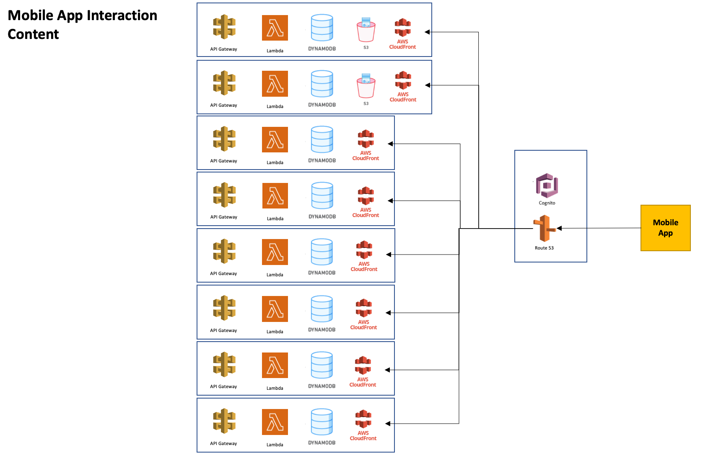
Coldplay App Key Considerations

Slide 12
Coldplay App Key Considerations
Compute:
Mobile App : 9 Lambda functions
Admin App : 26 Lambda functions
Stateless
Optimize reads, provide only those fields that are needed
Lambdas force you think of logic with shorter execution time and use limited resources

Slide 13
Thank You
Bharath Prasad
https://www.linkedin.com/in/bharathprasads/

